Slide 1
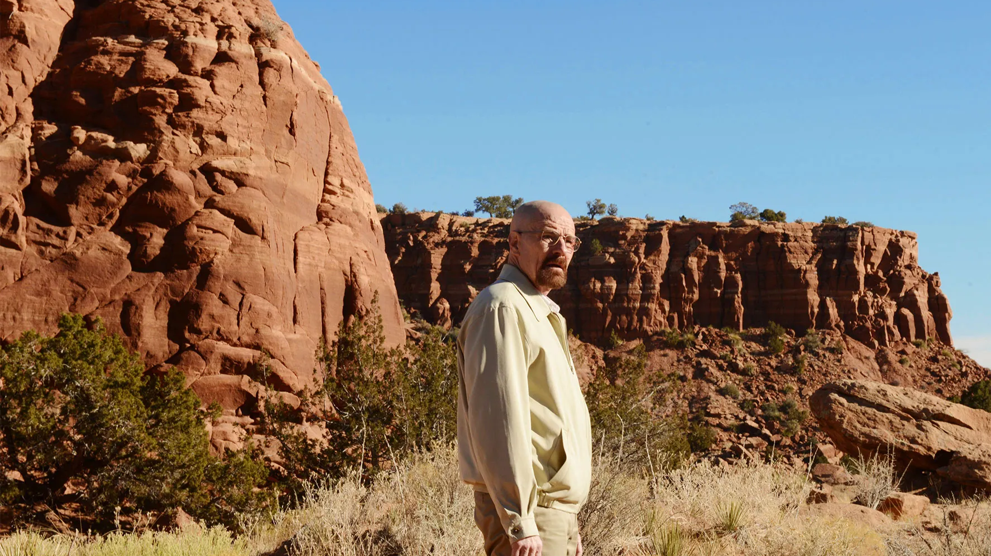
New Mexico

Slide 2
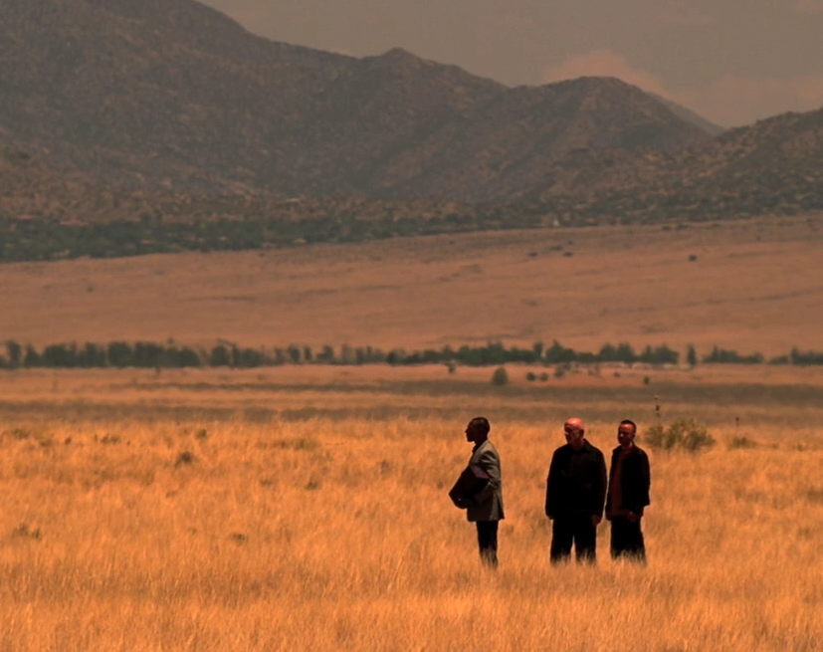
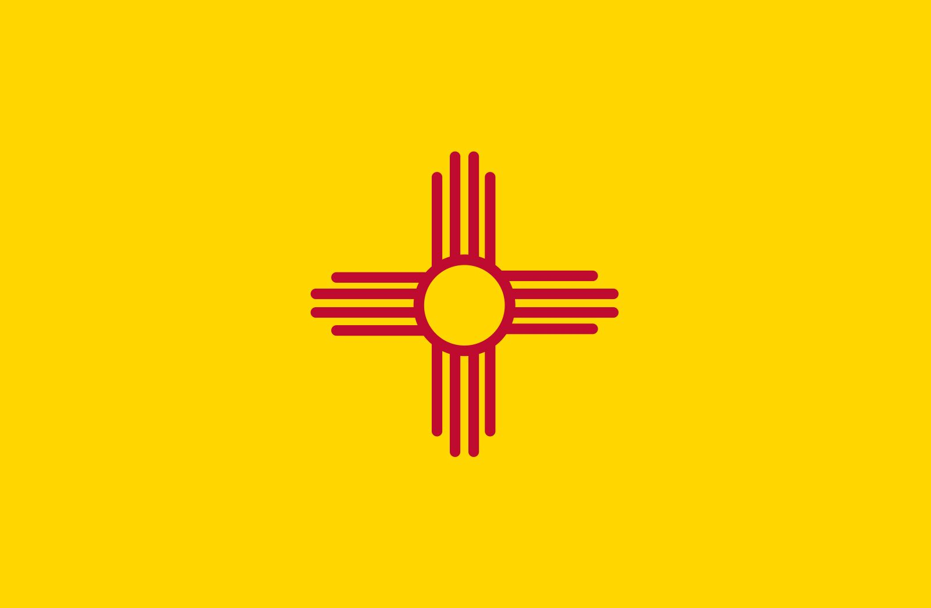
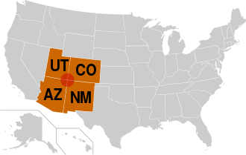
New Mexico - The Land of Enchantment
New Mexico is one of the Mountain States (Southwest)
Sharing the Four Corners region with Utah, Colorado and Arizona

Slide 3
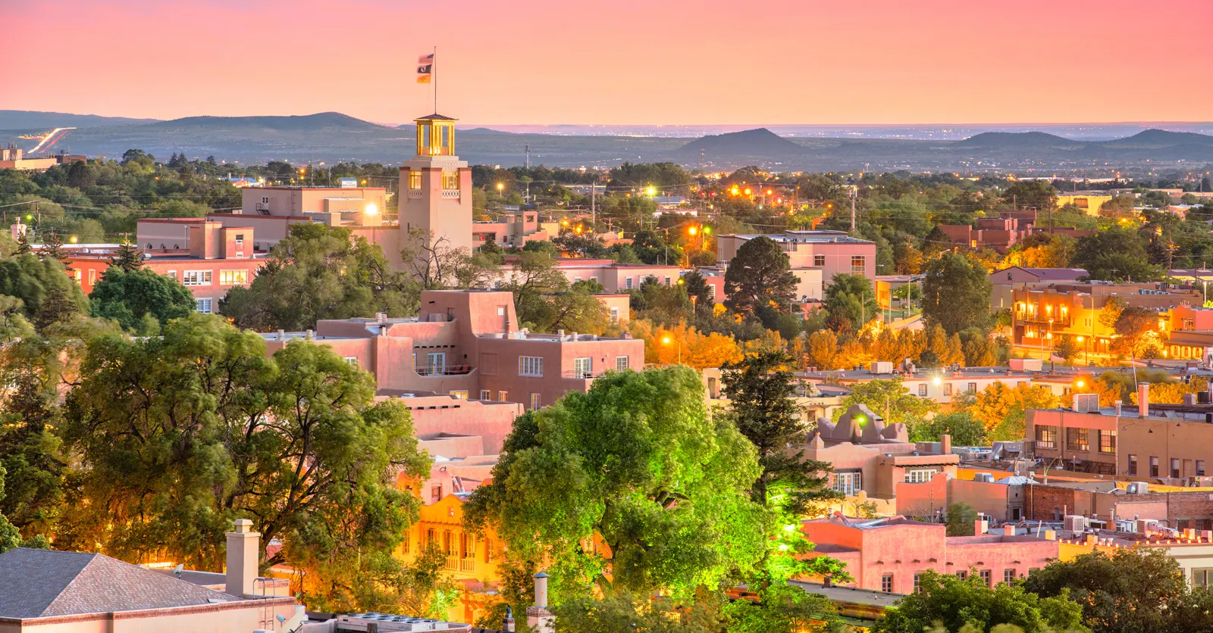

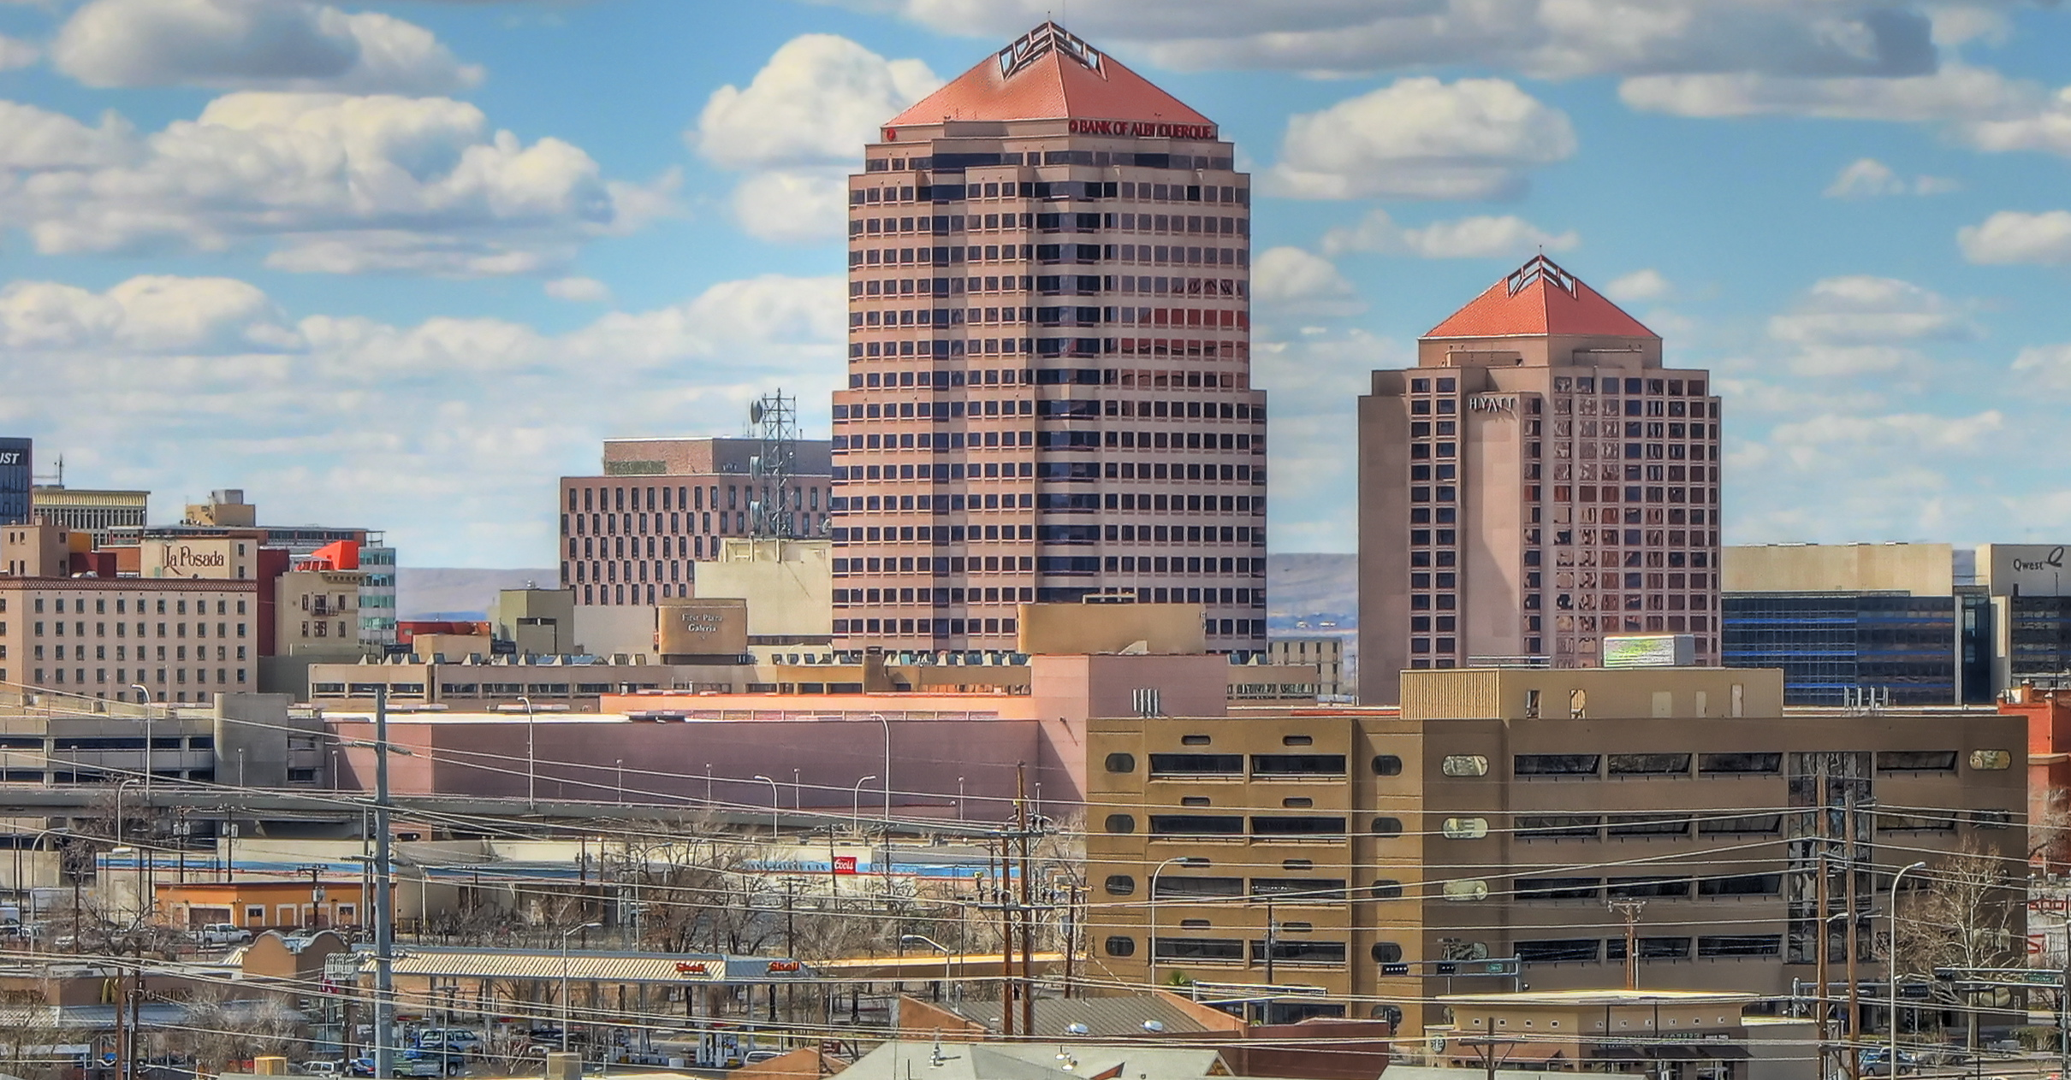
SOME INFORMATION
New Mexico's largest city is Albuquerque, and its state capital is Santa Fe
Santa Fe - 87,505 residents
Albuquerque - 564,559 residents

Slide 4
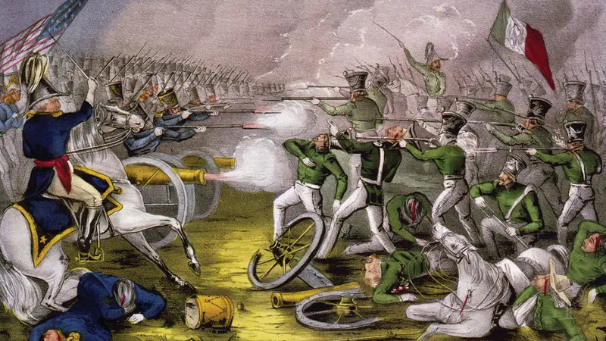
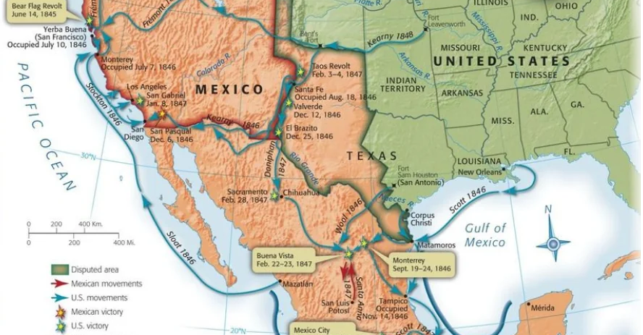
MORE INFORMATION
American invasion of Mexico in 1848, the U.S. annexed New Mexico,.
Significant U.S. military presence - White Sands Missile Range

Slide 5
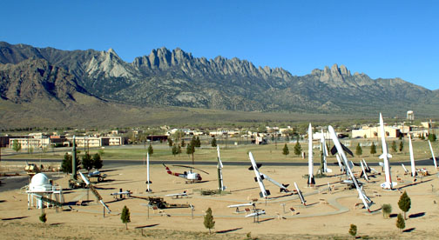
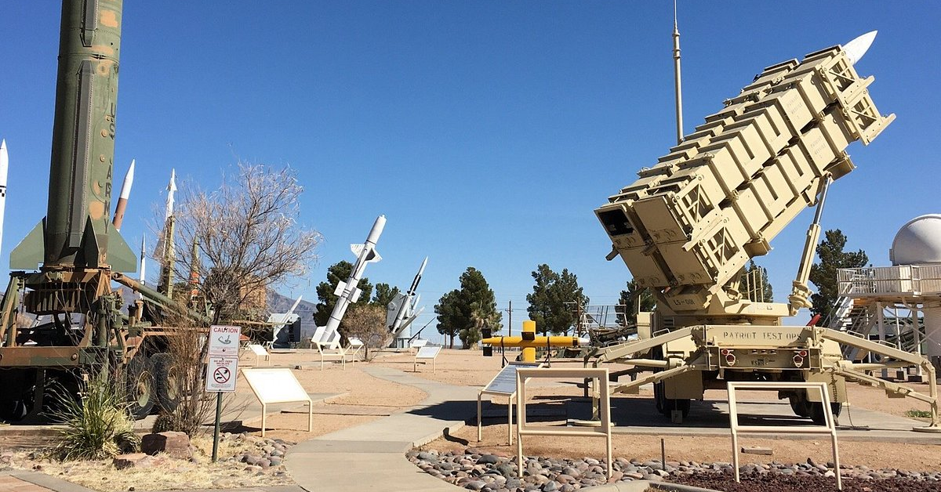
WHITE SANDS MISSILE RANGE AND NUCLEAR TESTS
WSMR is a US Army military testing area and firing range located in the US state of New Mexico
The range was originally established in 1941 - Alamogordo Bombing and Gunnery Range,
Trinity test site lay at the northern end of the Range

Slide 6
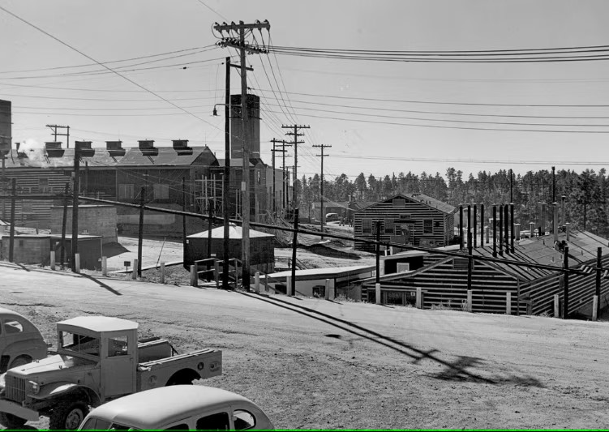
THE LOS ALAMOS
The Los Alamos Laboratory
Trinity - code name of the first detonation of a nuclear weapon, on July 16, 1945, as part of the Manhattan Project.

Slide 7
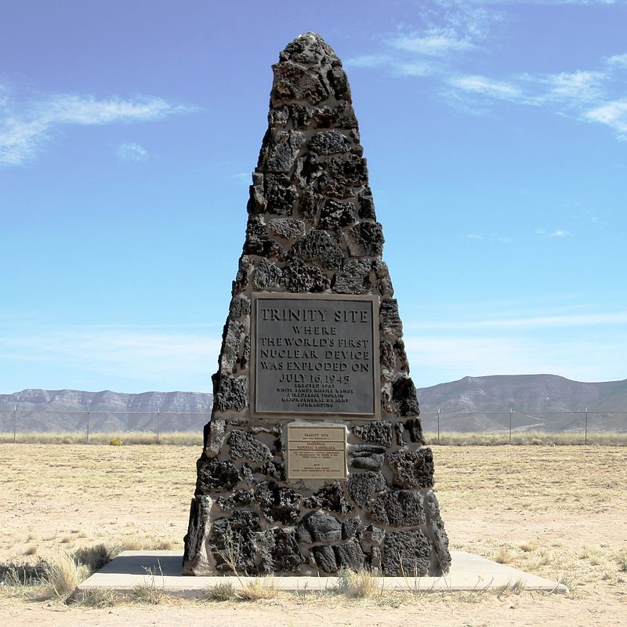
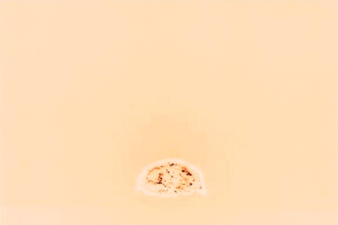
THE TRINITY
The test was conducted in the Jornada del Muerto desert 35 miles (56 km) southeast of Socorro, New Mexico, on what was the Alamogordo Bombing and Gunnery Range (renamed the White Sands Proving Ground just before the test).

Slide 8
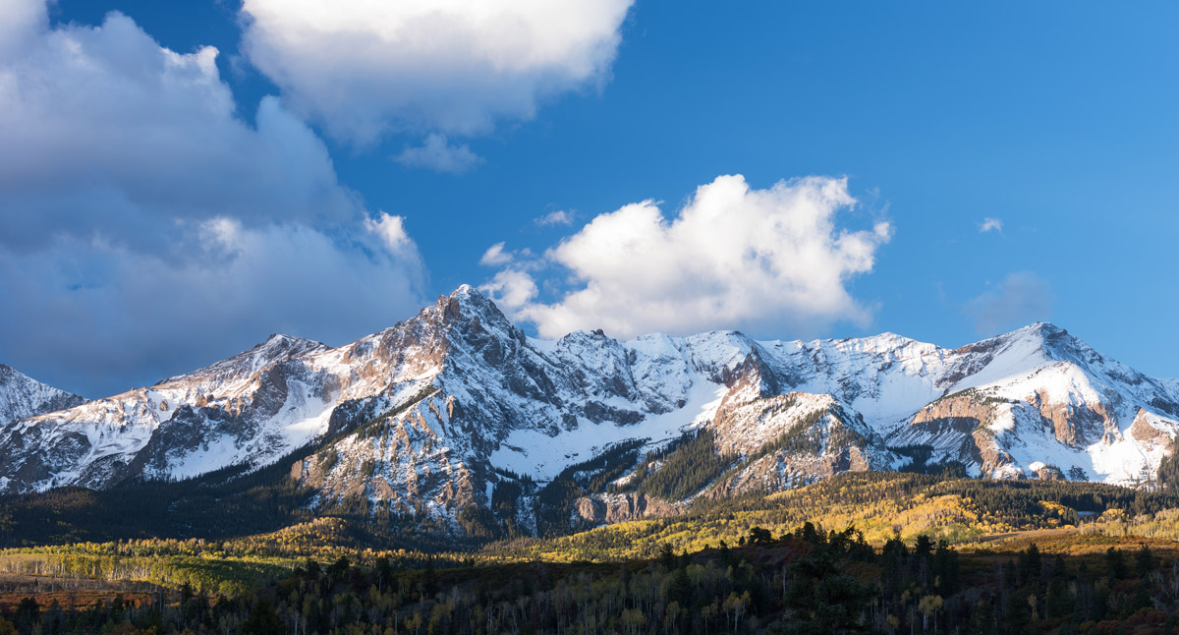
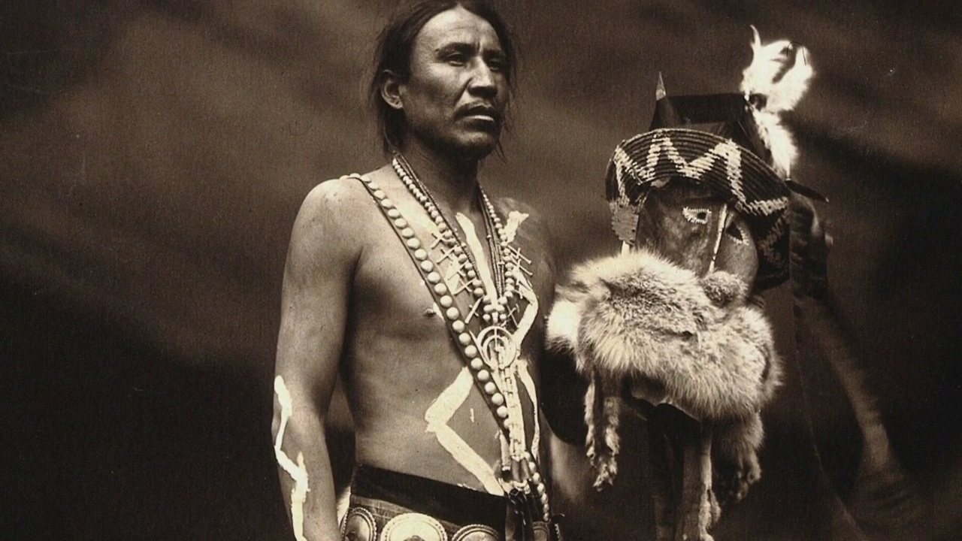
GEOGRAPHY AND HISTORY
The Southern Rocky Mountains
New Mexico has a rich and diverse history of Native American cultures.
The Native American communities and challenges.

Slide 9
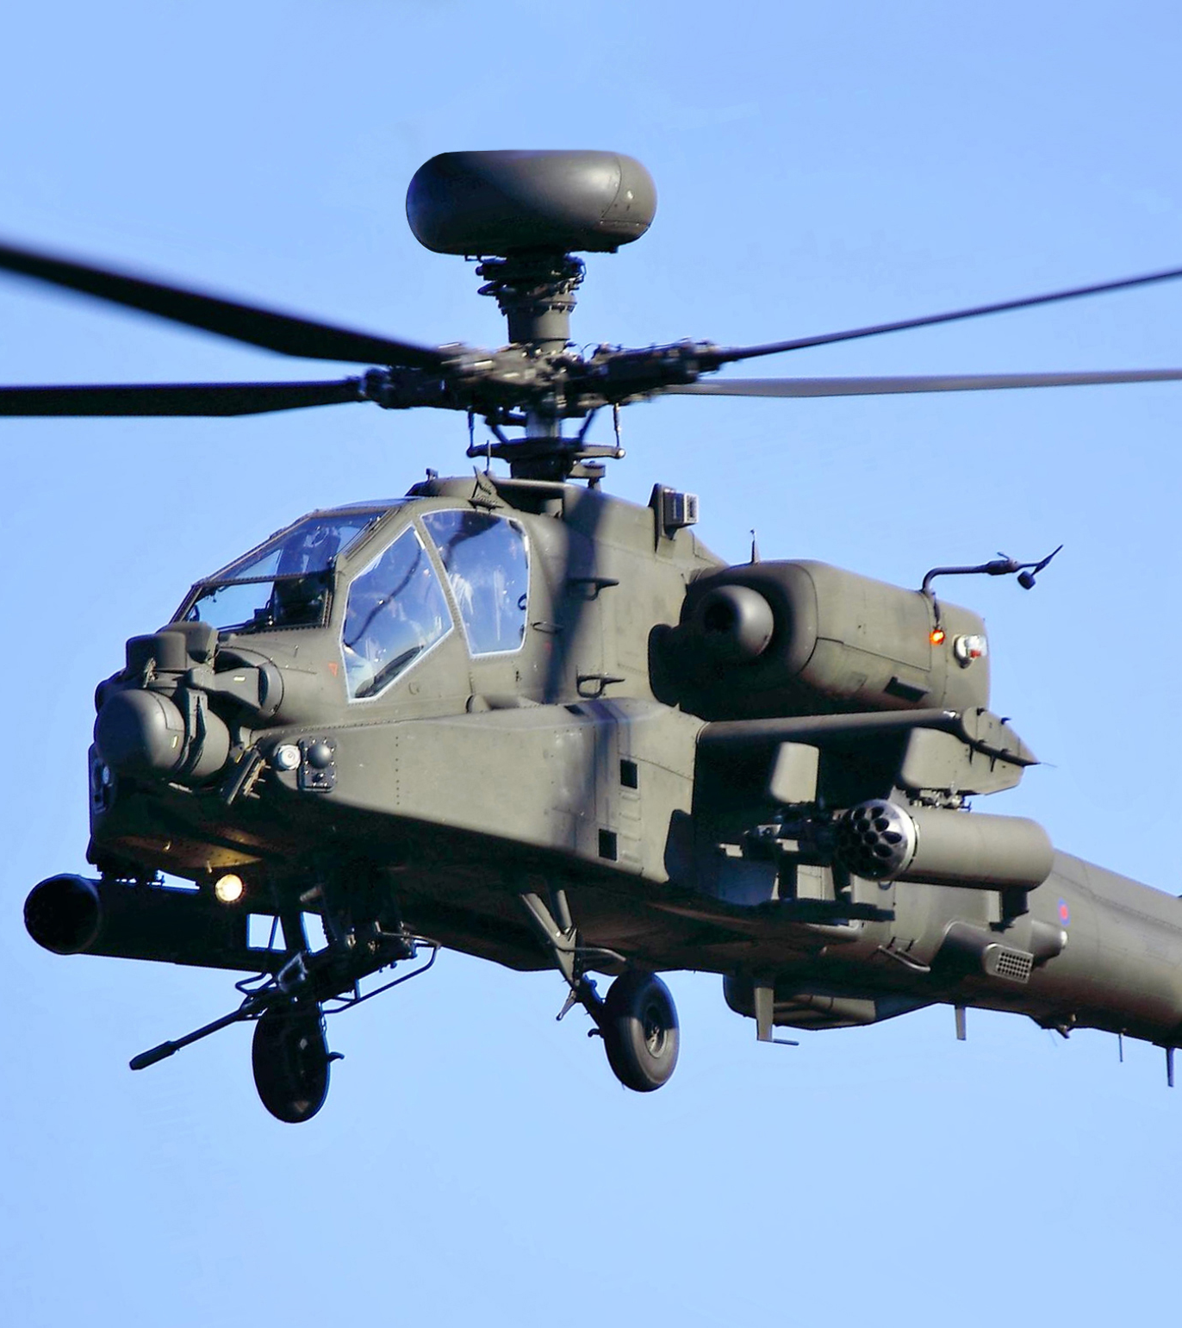
NATIVE AMERICANS
1. Pueblo People: Known for their advanced agricultural practices.
2. Navajo Nation: The Navajo Code Talkers, who played a crucial role in communication during World War II.
3. Apache Tribes: - their warrior traditions
4. Ute Tribe: - strong connection to the land.
* The AH-64 “Apache”

Slide 10
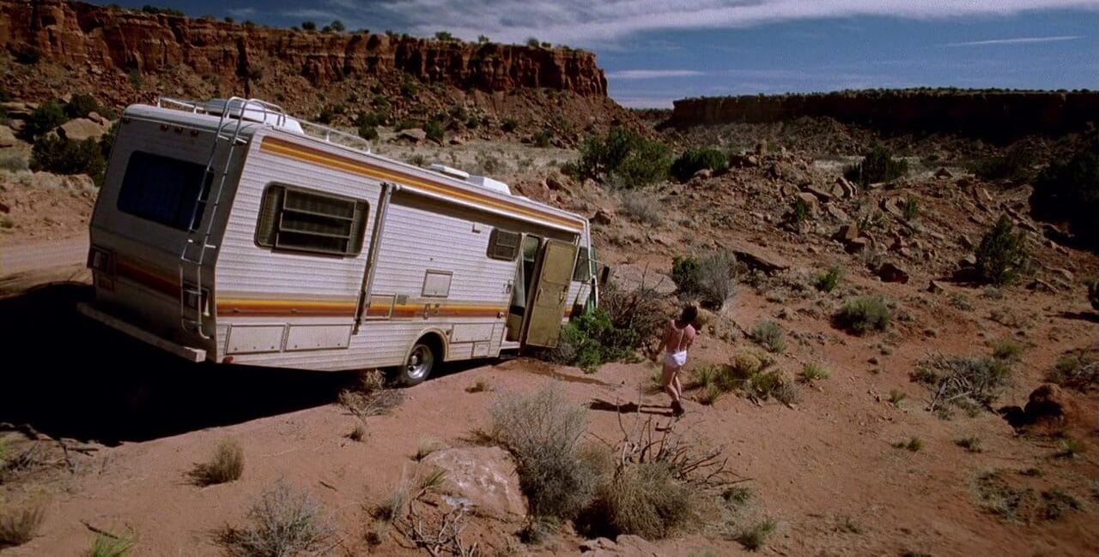
CONCLUSION
New Mexico - The Land of Enchantment.

